Slide 1

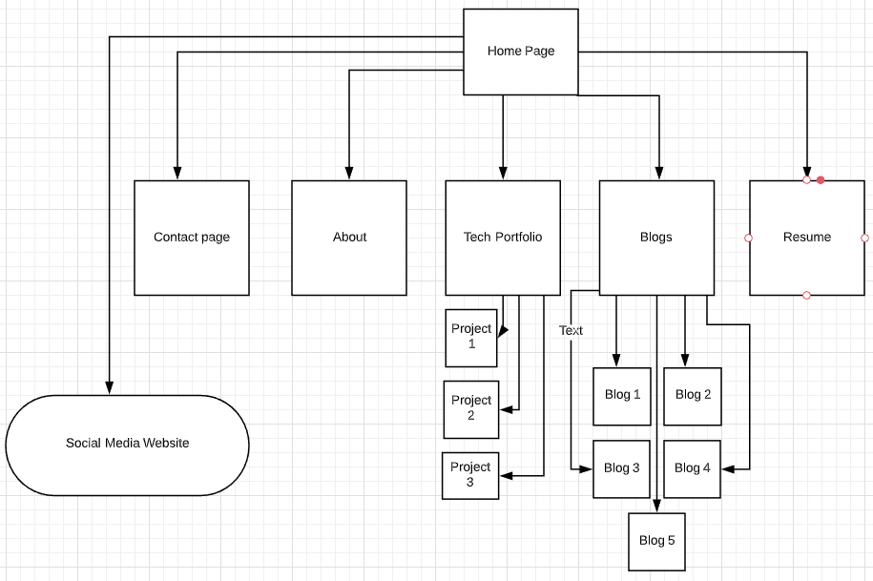
Portfolio
Walkthrough,
Overview of sitemap and all pages

Slide 2
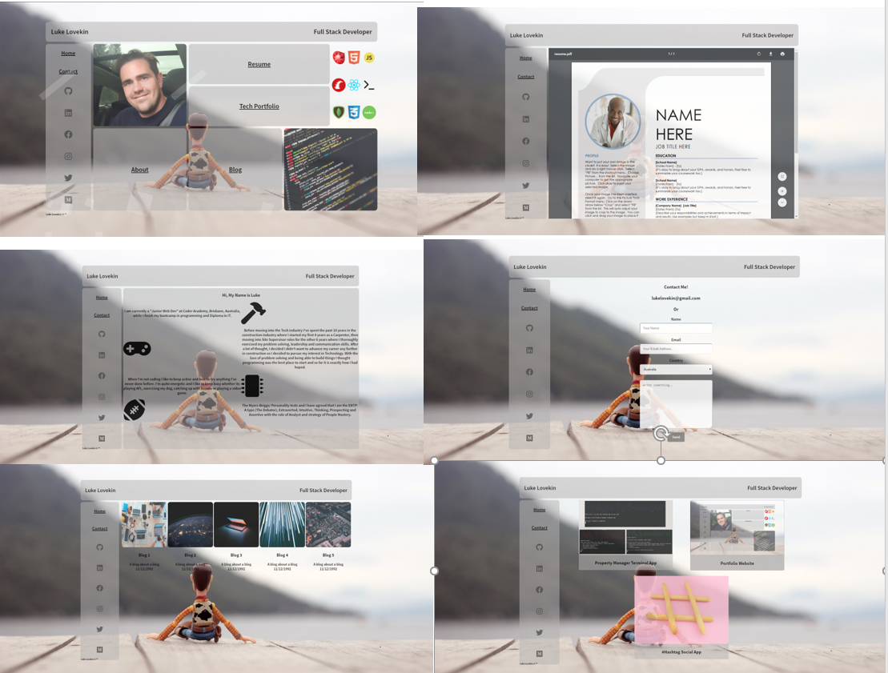
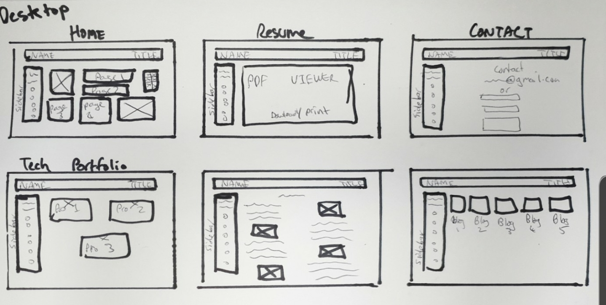
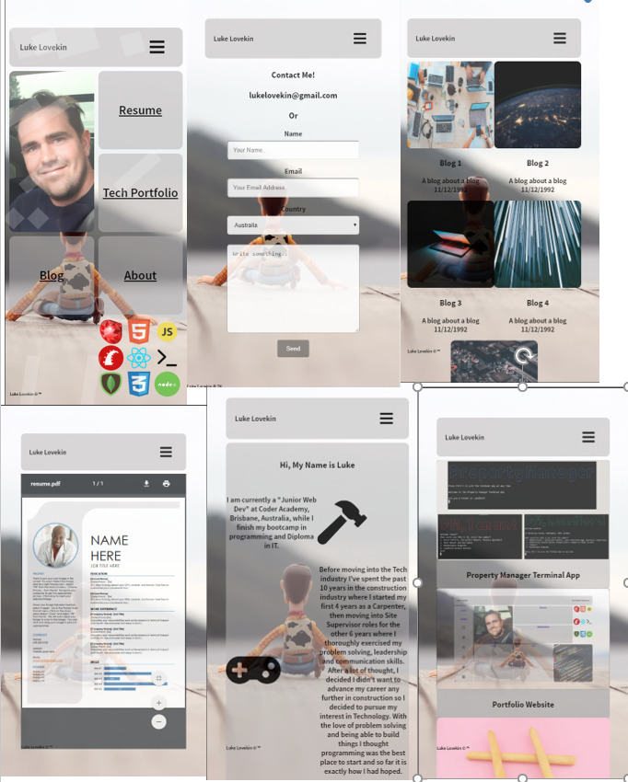
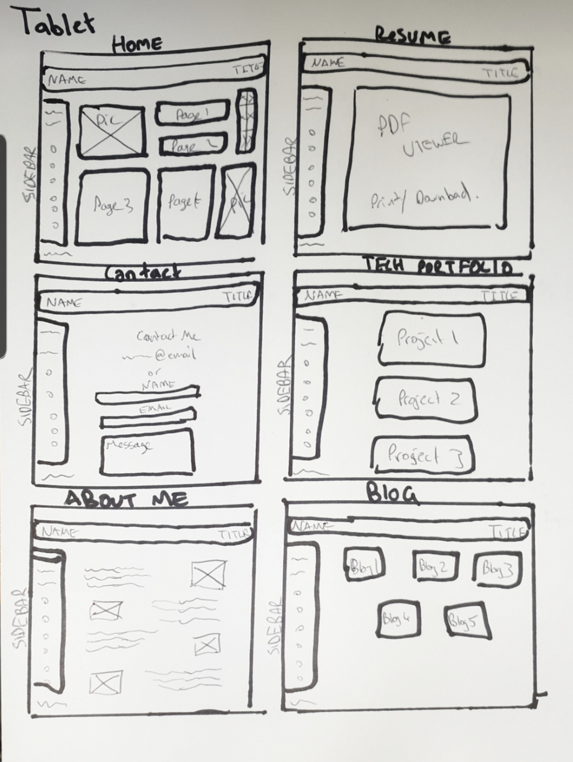
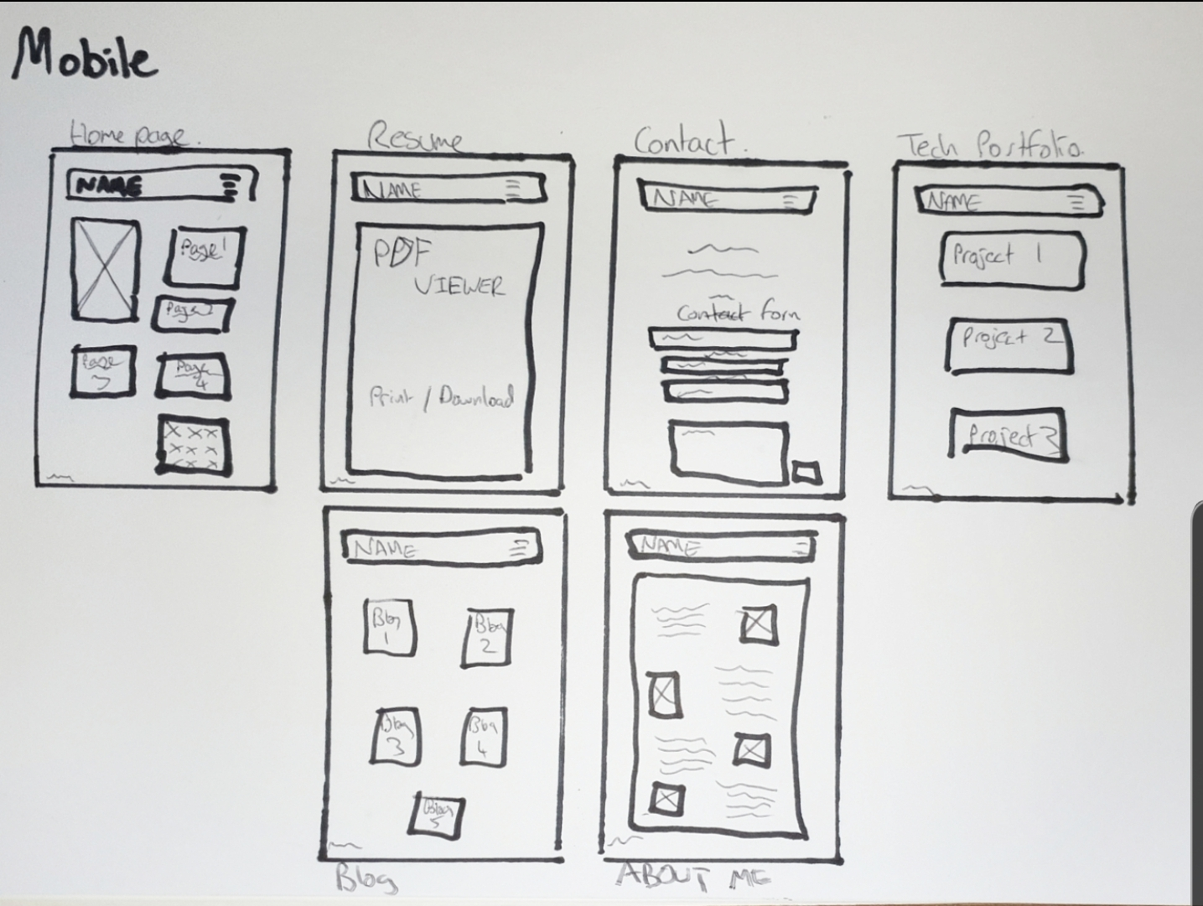
Portfolio
Design Process and Decisions
Decision making process / aesthetics
Development/build Process
List of components
How components and styling will engage the audience

Slide 3
Portfolio
Challenges
Ethical issues
Favorite part

